Slide 1
Experience vs. Practice in SE Education
Dror Feitelson
Hebrew University

Slide 2
Scene one

Slide 3
Ex3 in some programming course
Subject: loops
Input: read a list of numbers
End with EOF
Skip inputs that are not numbers
Processing:
Remove duplicates
Calculate square of each one
Sort them
Output: print list of squares
Exact format for automatic testing

Slide 4
Ex3 in some programming course
Subject: loops
Input: read a list of numbers
End with EOF
Skip inputs that are not numbers
Processing:
Remove duplicates
Calculate square of each one
Sort them
Output: print list of squares
Exact format for automatic testing
loop end
irrelevant

Slide 5
Ex3 in some programming course
Subject: loops
Input: read a list of numbers
End with EOF
Skip inputs that are not numbers
Processing:
Remove duplicates
Calculate square of each one
Sort them
Output: print list of squares
Exact format for automatic testing
foreach loop
nested loops

Slide 6
Ex3 in some programming course
Subject: loops
Input: read a list of numbers
End with EOF
Skip inputs that are not numbers
Processing:
Remove duplicates
Calculate square of each one
Sort them
Output: print list of squares
Exact format for automatic testing
Can combine sorting with duplicate removal

Slide 7
Ex3 in some programming course
Subject: loops
Input: read a list of numbers
End with EOF
Skip inputs that are not numbers
Processing:
Remove duplicates
Calculate square of each one
Sort them
Output: print list of squares
Exact format for automatic testing
nuisance

Slide 8
Ex3 in some programming course
Subject: loops
Input: read a list of numbers
End with EOF
Skip inputs that are not numbers
Processing:
Remove duplicates
Calculate square of each one
Sort them
Output: print list of squares
Exact format for automatic testing
missing:
loop invariants
loop variants

Slide 9
Ex3 in some programming course
Subject: loops
Input: read a list of numbers
End with EOF
Skip inputs that are not numbers
Processing:
Remove duplicates
Calculate square of each one
Sort them
Output: print list of squares
Exact format for automatic testing
Is this the most effective way to learn loops?

Slide 10
Scene two

Slide 11
The value of experience
Experienced developers are often more effective
Faster, work on autopilot
Use tools appropriate for the task
Produce better results
Experienced developers think differently
Higher level of abstraction
Deeper understanding of the system as a whole

Slide 12
Soloway & Ehrlich 1984
Experiments on differences between students and industrial professionals
Professionals know and use design patterns
Professionals know and use programming conventions
If patterns and conventions are violated, professionals are not much better than students

Slide 13
Arisholm et al. 2004
Experiment on maintenance of coffee machine software
Centralized style: front panel basically does everything (not good OOD)
Delegated: front panel just activates other modules (better OOD)
Students did better on centralized style
Inexperienced subjects had trouble with delegated style

Slide 14
Arisholm et al. 2004
Experiment on maintenance of coffee machine software
Centralized style: front panel basically does everything (not good OOD)
Delegated: front panel just activates other modules (better OOD)
Students did better on centralized style
Inexperienced subjects had trouble with delegated style
How is effective experience built?

Slide 15
Scene three

Slide 16
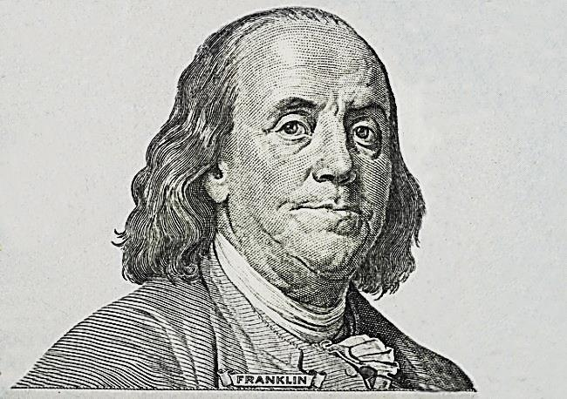
Benjamin Franklin
Author, printer, political theorist, politician, freemason, postmaster, scientist, inventor, civic activist, statesman, and diplomat
Founding father: signer of both the Declaration of Independence and the Constitution

Slide 17
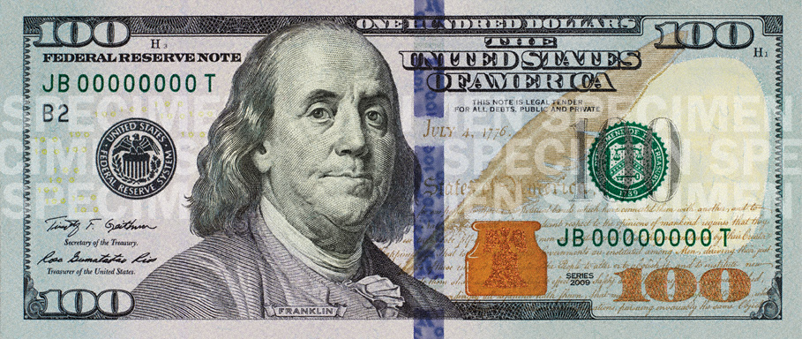
Benjamin Franklin
Author, printer, political theorist, politician, freemason, postmaster, scientist, inventor, civic activist, statesman, and diplomat
Founding father: signer of both the Declaration of Independence and the Constitution
On $100 bills since 1928

Slide 18
Benjamin Franklin
Author, printer, political theorist, politician, freemason, postmaster, scientist, inventor, civic activist, statesman, and diplomat
Founding father: signer of both the Declaration of Independence and the Constitution
On $100 bills since 1928
How did he learn to write well?

Slide 19
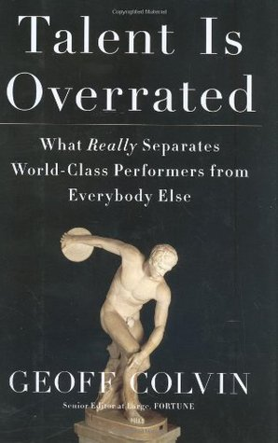
Pages 105-108
Based on Franklin’s autobiography

Slide 20
Obtain examples of clearly superior prose (the spectator periodical)
Read articles and make notes of the meaning of each sentence
A few days later, express these meanings in his own words
Compare with original to see how it could be done better
Rewrite whole essays in verse, to improve vocabulary (rhyming requires ability to express a thought in different ways to fit)

Slide 21
Later convert back to prose and compare with original
Write a note on each sentence on a separate slip of paper and mix them
Weeks later, try to put them back in correct order and compare with original
Did this workdays before and after work (as a printer) and on Sundays
Didn’t write essays “to practice”

Slide 22
what
we
do
know
about
experts
?

Slide 23
Simon & Chase 1973
Chess
Masters have a “vocabulary” of meaningful positions
See patterns of attack or defense, not individual pieces
Can recognize and reconstruct game boards at a glance
Achieving mastery takes 10 years of hard work
Even Bobby Fischer needed 9

Slide 24
Ericsson et al. 1993
“Deliberate practice”
World-class musicians and other performing artists
Champion athletes and sports teams
Army fighter pilots and civil pilots
Medical doctors and X-ray analysts
And more…

Slide 25
Deliberate practice
Designed specifically to improve performance on a well-defined activity
More practice is waste of time
Comfort zone
Effective improvement
Learning zone
Ineffective
Panic zone
Attributed to Noel Tichy

Slide 26
Deliberate practice
Designed specifically to improve performance on a well-defined activity
Typically by a knowledgeable teacher
Just beyond your current ability
Repeated a lot
Focus exclusively on the important part
With immediate feedback
Need to know how well you did to improve
Not fun
Challenge yourself to conquer new ground
Most people don’t have the required self discipline

Slide 27
Deliberate practice
Designed specifically to improve performance on a well-defined activity
Typically by a knowledgeable teacher
Just beyond your current ability
Repeated a lot
Focus exclusively on the important part
With immediate feedback
Need to know how well you did to improve
Not fun
Challenge yourself to conquer new ground
Most people don’t have the required self discipline
Just practicing for 10 years is not enough – it has to be done right!

Slide 28
Experience ⇨ expertise
deliberate practice
performance
improvement
more experience
time

Slide 29
10 years
Need deliberate practice of 10000 hours
Over 10 years
That’s 1000 hours a year
That’s about 3 hours a day, every day
Deliberate practice requires intense concentration
Can’t be done a whole day, but some should be done every day

Slide 30
Pilots have simulators to practice turns and landings over and over again safely and inexpensively
What is the equivalent for software engineers
?

Slide 31
Reading before writing
Glass / Facts and Fallacies of Software Engineering, 2003
Fallacy #10: You teach people how to program by showing them how to write programs
More important to read great programs written by others
Just like learning any other foreign language
Especially in the age of maintenance

Slide 32
Personal software process
Watts Humphrey / Introduction to the Personal Software Process, 1997
Practice time management from the start
Meticulously record all activities performed
Analyze time investment
Learn to predict realistic schedules
Practice bug tracking from the start
Meticulously record all bugs and fixes
Learn to assess and predict quality

Slide 33
Agile development
Constant feedback from peers
Peer review of code before each commit
Constant feedback from client
Potentially shippable increment of working software every few weeks
Client decides whether to accept it
New requirements emerge from experience with use
Reflection on process
Sprint retrospective in Scrum

Slide 34
The new Ex3
Write 100 loops for different situations
For each one show it terminates using a loop variant
For each one identify a loop invariant
Estimate the number of iterations as a function of the input
Write 100 recursive functions for different situations
Show why each one must eventually terminate
Estimate the number of calls as a function of the input

Slide 35
Learning à la Franklin
Use well-known open source libraries to practice interface definition
Given general spec, define the interface and contract for each function
Compare with that of the original library
Given the functions, write the documentation for each one
Compare with that of the original library (is yours perhaps better?)
Don’t really implement any of it

Slide 36
Learning à la Franklin
Use well-known open source projects to practice modularity and design
Given general spec, define the modules and main interactions between them
Compare with that of the original project’s decomposition
Given the architecture, define the methods for each class
Compare with those of the original project
Don’t really implement any of it

Slide 37
Learning à la Franklin
Practice exception handling
Given library functions, define contracts
Focus on preconditions (and throwing exceptions) vs. handling problematic inputs
Compare with that of the original library/project
Example: List::get()
Option 1: if list is empty return null reference
Option 2: if list is empty throw an exception
Discuss implications in 100 such cases

Slide 38
The agenda
Identify problem spot
What we are generally bad at
Devise deliberate practice plan
Many focused practice examples
Method for evaluation and feedback
Evaluate in practice
Implement in a course
Repeat

Slide 39
Any questions?
Any volunteers?

