Slide 1
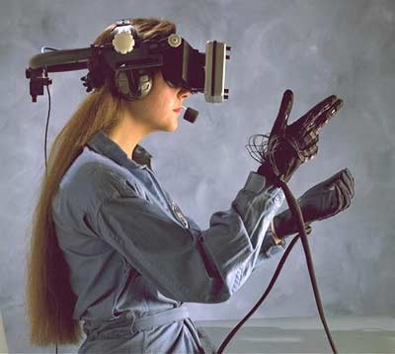
Competitive and Deterministic Embeddings of Virtual Networks
Guy Even &
Moti Medina
EE Tel-Aviv University
Gregor Schaffrath &
Stefan Schmid
Deutsche Telekom Labs,
TU Berlin

Slide 2
Virtualization
A method for providing an abstraction of a logical entity over a physical one.

Slide 3
Network Virtualization
Virtual Network (VNet)
An abstraction of a network over a given set of terminals.
Establishing a VNet
Requires embedding a subnetwork that spans the terminals of the VNet in the physical network (substrate network).
Main Characteristic
A specification of the traffic between terminals.
The embedding must support this specification.
A benefit is associated with each VNet request.
Goal
Satisfying as many VNet requests as possible in a given physical network.

Slide 4
An Example
Link is saturated
Link capacity 1Mbps.
Two VNet requests:
{ }, ½ Mbps,
{ }, ½ Mbps,
Link is saturated

Slide 5
VNet Service Models
i
j
Traffic
Customer-pipe model
Traffic matrix that specifies
the required BW between
every pair of terminals.
Not necessarily symmetric.
Hose model [DGGMRM 99], [FST 97]
Each terminal is assigned a max ingress BW and a max egress BW.
Applications
Balanced
Video Conf.
i
3
j
7
ingress
v
egress

Slide 6
VNet Service Models, cont.
Traffic, cont.
Aggregate ingress model (new)
A parameter I.
Any traffic in which the sum of ingress BW is at most I must be served.
Application
Non-balanced VC.
u
ingress
v
ingress
w
ingress

Slide 7
VNet Service Models, cont.
Routing
Tree routing
A Steiner tree over the terminals of the VNet.
Single path routing
Each pair of terminals communicates along
a single path.
Multipath routing
Each pair of terminals communicates along
multiple paths.
A VNet request:

Slide 8
Problem Definition
Undirected communication network
V - is the set of substrate nodes.
E - is the set of links.
c – link capacity function.
Sequence of VNet requests .
Upon arrival of a request
Either embed or reject .
The set of valid embeddings of depends on the service model.

Slide 9
Problem Definition, cont.
Every request is a 5-tuple
A set of terminals .
A set of allowed traffic patterns between the terminals .
Routing model
Multi path, single path, or tree.
Benefit .
Goal
Maximize the sum of the benefits of the embedded VNets.

Slide 10
Overall Profit & Competitive Analysis
Overall profit = Sum of the benefits of the embedded VNets.
We consider the Online version:
Competitive analysis.
For every input sequence σ,
|Alg(σ)| ≥ 1/ρ•|OPT(σ)|.
Alg – deterministic online algorithm.
OPT – offline optimum.
|Alg| - overall profit of algorithm Alg.
ρ – competitive ratio

Slide 11
Previous Work
Online
A general primal-dual setting for online packing and covering
[Buchbinder & Naor 2006,2009,2009]
Special cases of VNet embeddings:
Online Circuit switching [Awerbuch, Azar, Plotkin 93]
O(log n) competitiveness.
Multiple multicast request
[Awerbuch & Azar 95]
The terminals of the requests arrive in an arbitrarily interleaved order.
O(log n •log (diameter) competitiveness.
Hose model with tree routing.
[Grewal, Budhiraja 2008], [Liu,Sun,Chen 2006]
Edge costs are the ratio between the demand and the residual capacity
Even for online circuit switching leads to Ω(n) comp. ratio.
Rejection ratio is analyzed (Competitive ratio was not studied).
Mainly experimental
Embedding multicast requests [Kodialam, Lakshman, Sengupta 2003].
[Fan, Ammar 2006], [Zhu, Ammar 2006],…

Slide 12
Previous Work, cont.
Offline
Customer pipe model with multipath routing
Optimal fractional solution (by solving A MCF problem).
2-approx integral solution [Jain 2001]
Hose model
Tree routing: O(1) - approx
[Eisenbrand, Grandoni 2005], [Grandoni, Rothvoss 2010], [Gupta, Kumar, Roughgarden 2003].
The algs compete with an optimal single path routing.
Multipath routing
Optimal
[Erlbach, Ruegg 2004]

Slide 13
Main Result
Deterministic online algorithm for maximizing overall profit.
Heterogeneous
Supports VNet requests of multiple traffic and routing models.
Competitive ratio –
logarithmic in the resources of the network
Number of links,
Max link capacity,
Max benefit.
Does not depend on the number of requests.

Slide 14
Algorithm Outline
Main Technique
Extension of [AAP93] and [BN06]
Integrally packing paths by a centralized online algorithm.
log(n) – competitiveness.
Edge costs: exponential in the load of the edge.
Oracle: Finds a shortest path.
Alg :
If the cost of the path is higher then its benefit, then reject,
Otherwise, accept.
Oracle
Oracle
Resource Manager
Oracle

Slide 15
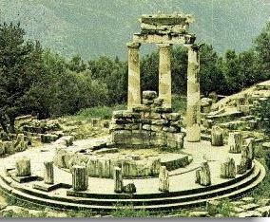
Algorithm Outline, cont.
Main Technique
The Reduction
Now, the requests are subgraphs.
Every request increases the load of edges that it uses.
The edge cost is updated.
The Oracle finds a subgraph that supports the request.
The Oracle(s)
Is an offline approximation algorithm(s) for the same problem(s)(!!)
A reduction from Online to Offline.
Oracle
Oracle
Resource Manager
Oracle

Slide 16
Main Result
Consider a sequence of VNet requests
that consists of requests from one of the following types
Customer pipe model with multipath routing,
Hose model (Multipath, Single path, Tree),
Aggregate ingress model (Multipath, Single path, Tree).

Slide 17
Main Result, cont.
(α, β)-competitive:
α – fraction of throughput.
β – capacity augmentation.

Slide 18
Main Result, cont.
Corollaries
If Y is an (α, β)-competitive then
⇒ Y/ β is a fractional α•β-competitive .
If capacities ≫ demands, then
scale capacities by 1/ β .
⇒ Integral α•β-competitive .
Analysis
Formalizing the problem as a packing linear program.
Applying the Primal-Dual Scheme by Buchbinder & Naor.

Slide 19
Extensions
VNet Service Models
Packet Rate
A router needs to inspect each packet ➔ router load.
Finite duration.
Using approximate oracles.
Competitive ratio – logarithmic in the resources of the network
Approximation ratio of the oracle,
Number of links,
Max link capacity,
Number of nodes,
Max node capacity,
Max benefit,
Max duration.

Slide 20
Thank you

