Slide 1
Resampling with Feedback
A New Paradigm of Using Workload Data for Performance Evaluation
Dror Feitelson
Hebrew University

Slide 2
Performance Evaluation
“Experimental computer science at its best” [Denning 1981]
Major element of systems research
  Compare design alternatives
  Tune parameter values
  Assess capacity requirements
Very good when done well
Very bad when not
  Miss missions objectives
  Waste of resources

Slide 3
Workload = Input
Algorithms
Systems
Worst case time/space
bounds
Input
instance
Algorithm
Average response-time /throughput metrics
Workload
System
Notes:
Using average => statistics matter

Slide 4
Representativeness
Average ⇨ statistics matter
Evaluation workload has to be representative of real production workloads
Achieved by using the workloads on existing systems
Analyze the workload and create a model
Use workload directly to drive a simulation

Slide 5

A 20-Year Roller Coaster Ride
Models are great
Models are oversimplifications
Logs are the real thing
Logs are inflexible and dirty
Resampling can solve many problems
Provided feedback is added
Image Credit: Roller Coaster from vector.me (by tzunghaor)

Slide 6
The JSSPP Context
Job scheduling, not task scheduling
  Human in the loop
Simulation more than analysis
    Minute details matter

Slide 7
Outline for Today
Background – parallel job scheduling
Workload models ups and downs
Using logs directly ups and downs
Resampling workloads
Adding feedback
Examples of evaluation results

Slide 8
Outline for Today
Background – parallel job scheduling
Workload models ups and downs
Using logs directly ups and downs
Resampling workloads
Adding feedback
Examples of evaluation results

Slide 9
Parallel Jobs
A set of processes that cooperate to solve a problem
  Example: weather forecast, industrial/military simulation, scientific discovery
Processes run in parallel on distinct processors, communicate using high-speed network
Run to completion on dedicated processors to avoid memory problems
Require rectangle in processorsXtime space
Notes:
Parse the title

Slide 10
Parallel Job Scheduling
Each job is a rectangle in processorsXtime space
Given many jobs, we must schedule them to run on available processors
This is like packing the rectangles
Want to minimize space used, i.e. minimize used resources and fragmentation
On-line problem: don’t know future arrivals or runtimes

Slide 11
FCFS and EASY
FCFS
EASY

Slide 12
FCFS and EASY
FCFS
EASY

Slide 13
FCFS and EASY
FCFS
EASY

Slide 14
FCFS and EASY
FCFS
EASY

Slide 15
FCFS and EASY
FCFS
Queued jobs
EASY

Slide 16
FCFS and EASY
FCFS
Queued jobs
EASY

Slide 17
FCFS and EASY
FCFS
backfilling
Queued jobs
EASY

Slide 18
FCFS and EASY
FCFS
Queued jobs
EASY

Slide 19
FCFS and EASY
FCFS
Queued jobs
EASY

Slide 20
Evaluation by Simulation
What we just saw is a simulation of two schedulers
Tabulate wait times to assess performance
  In this case, EASY was better
It all depends on the workload
  In this case, combinations of long-narrow jobs
So the workload needs to be “representative”

Slide 21
Workload Data
Ensure representativeness by using real workloads
Job arrival patterns
Job resource demands (processors and runtime)

Slide 22
Outline for Today
Background – parallel job scheduling
Workload models ups and downs
Using logs directly ups and downs
Resampling workloads
Adding feedback
Examples of evaluation results

Slide 23
Workload Modeling
Identify important workload attributes
Collect data (empirical distributions)
Fit to mathematical distributions
Used for random variate generation as input to simulations
Used for selecting distributions as input to analysis
Typically assume stationarity
  Evaluate the system is a “steady state”

Slide 24

Modeling is Great!
Models embody knowledge
Models allow for controlled experiments
Modeled workloads have good statistical properties
Models avoid problems in logs
  Bogus data
  Local limitations

Slide 25
Modeling is Great!
Models embody knowledge
Models allow for controlled experiments
Modeled workloads have good statistical properties
Models avoid problems in logs
  Bogus data
  Local limitations
Know about distributions
Know about correlations
Can exploit this in designs

Slide 26
Modeling is Great!
Models embody knowledge
Models allow for controlled experiments
Modeled workloads have good statistical properties
Models avoid problems in logs
  Bogus data
  Local limitations
Change one workload parameter at a time (e.g. load) and see its effect

Slide 27
Modeling is Great!
Models embody knowledge
Models allow for controlled experiments
Modeled workloads have good statistical properties
Models avoid problems in logs
  Bogus data
  Local limitations
Modeled workloads are usually stationary
Faster convergence of results

Slide 28
Modeling is Great!
Models embody knowledge
Models allow for controlled experiments
Modeled workloads have good statistical properties
Models avoid problems in logs
  Bogus data
  Local limitations
Jobs that were killed
Strange behaviors of individual users

Slide 29
Modeling is Great!
Models embody knowledge
Models allow for controlled experiments
Modeled workloads have good statistical properties
Models avoid problems in logs
  Bogus data
  Local limitations
e.g. constraint that jobs are limited to 4 hours max

Slide 30

Whoop-dee-doo!

Slide 31
But…
Models include only what you put in them
Corollary: they do not include two things:
  What you THINK is NOT important*
  What you DON’T KNOW about
You could be wrong about what is important*
What you don’t know might be important*
* Important = affects performance results

Slide 32
Unexpected Importance I
EASY requires user runtime estimates to plan ahead – backfilling
Typically assumed to be accurate
They are not
CTC
KTH

Slide 33
Unexpected Importance I
EASY requires user runtime estimates to plan ahead – backfilling
Typically assumed to be accurate
They are not
This may have a large effect on results
  Cause holes to be left in the schedule
  Small holes are suitable for short jobs
  Causes an SJF-like effect
  “worse estimates lead to better performance”
Mu'alem & Feitelson, IEEE TPDS 2001; Tsafrir & Feitelson, IISWC 2006

Slide 34
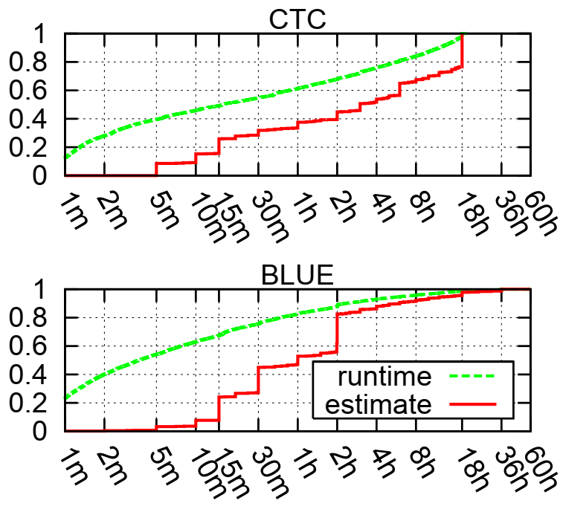
Need to Model Estimates
Models which assume accurate runtime estimates lead to overly optimistic results
Need to include realistic estimates in the models
  Use of few discrete values
  Use of maximal allowed values
Tsafrir, Etsion, & Feitelson, JSSPP 2005; Tsafrir JSSPP 2010

Slide 35
Unexpected Importance II
Daily cycle of activity often ignored
  Focus on prime time only = most demanding load
Turned out to be important in user-aware scheduler
Implication: workloads are actually not stationary
  The system is always in a transient state
  Confidence intervals become meaningless

Slide 36
User-Aware Scheduler
Prioritize jobs with short expected response times
  Correlated with short think times
  An attempt to keep users satisfied and extend user sessions
This also improves system utilization and throughput
Balance with job seniority to prevent starvation
Shmueli & Feitelson, IEEE TPDS 2009

Slide 37
Performance
Load is expressed as the number of active users
The higher the emphasis on responsiveness, the higher the achieved utilization
No weight for responsiveness is the same as EASY
EASY
Notes:
Red is EASY

Slide 38
Daily Cycle
Improved throughput depends on
  User behavior (leave if jobs delayed)
  Scheduler design (prioritize interactive jobs)
  Daily cycle of activity
During the day, accept higher load than can be sustained
  Delay batch jobs
During the night drain the excess jobs, using resources that would otherwise remain idle
Model without daily cycle shows no improvement
Feitelson & Shmueli, MASCOTS 2009

Slide 39
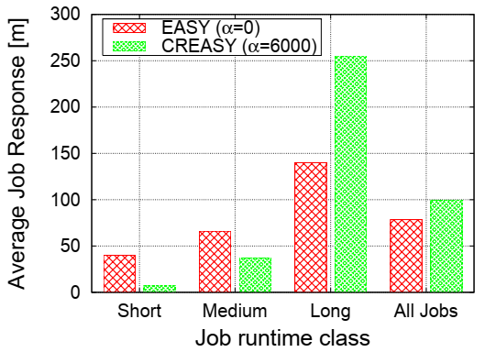
Daily Cycle
Improved throughput depends on
  User behavior (leave if jobs delayed)
  Scheduler design (prioritize interactive jobs)
  Daily cycle of activity
During the day, accept higher load than can be sustained
  Delay batch jobs
During the night drain the excess jobs, using resources that would otherwise remain idle
Model without daily cycle shows no improvement
Feitelson & Shmueli, MASCOTS 2009

Slide 40
Unexpected Importance III
Workload assumed to be a random sample from a distribution
Implies stationarity
  Good for convergence of results
Also implies no locality
  Statistically, nothing ever changes
  Cannot learn from experience
Stationary model workloads cannot be used to evaluate adaptive systems

Slide 41

Oh damn…

Slide 42
Outline for Today
Background – parallel job scheduling
Workload models ups and downs
Using logs directly ups and downs
Resampling workloads
Adding feedback
Examples of evaluation results

Slide 43
Using Accounting Logs
In simulations, logs can be used directly to generate the input workload
  Jobs arrive according to timestamps in the log
  Each job requires the number of processors and runtime as specified in the log
Used to evaluate new scheduler designs
  Current best practice
Includes all the structures that exist in real workloads
  Even if you don’t know about them!

Slide 44
Parallel Workloads Archive
All large scale supercomputers and clusters maintain accounting logs
Data includes job arrival, queue time, runtime, processors, user, and more
Many are willing to share them
(and shame on those who are not)
Collection at www.cs.huji.ac.il/labs/parallel/workload/
Uses standard format to ease use
Feitelson, Tsafrir, & Krakov, JPDC 2014

Slide 45
Example: NASA iPSC/860 trace
user | command | proc | runtime | date | time
user8 | cmd33 | 1 | 31 | 10/19/93 | 18:06:10
sysadmin | pwd | 1 | 16 | 10/19/93 | 18:06:57
sysadmin | pwd | 1 | 5 | 10/19/93 | 18:08:27
intel0 | cmd11 | 64 | 165 | 10/19/93 | 18:11:36
user2 | cmd2 | 1 | 19 | 10/19/93 | 18:11:59
user2 | cmd2 | 1 | 11 | 10/19/93 | 18:12:28
user2 | nsh | 0 | 10 | 10/19/93 | 18:16:23
user2 | cmd1 | 32 | 2482 | 10/19/93 | 18:16:37
intel0 | cmd11 | 32 | 221 | 10/19/93 | 18:20:12
user2 | cmd2 | 1 | 11 | 10/19/93 | 18:23:47
user6 | cmd8 | 32 | 167 | 10/19/93 | 18:30:45
Notes:
Logs have 10^5 to 10^6 jobs

Slide 46
Usage
Growing usage of the PWA
About 100 papers a year
More than 1500 cumulative

Slide 47
Whoop-dee-doo!

Slide 48
But…
Logs provide only a single data point
Logs are inflexible
  Can’t adjust to different system configurations
  Can’t change parameters to see their effect
Logs may require cleaning
Logs are actually unsuitable for evaluating diverse systems
  Contain a “signature” of the original system

Slide 49
Beware Dirty Data
Using real data is important
But is ALL real data worth using?
  Errors in data recording
  Evolution and non-stationarity
  Diversity between different sources
  Multi-class mixtures
  Abnormal activity
Need to select relevant data source
Need to clean dirty data

Slide 50
Abnormality Example
Some users are much more active than others
So much so that they single-handedly affect workload statistics
Job arrivals (more)
Job sizes (modal?)
Probably not generally representative
Are we optimizing the system for user #2?

Slide 51
Workload Flurries
Bursts of activity by a single user
  Lots of jobs
  All these jobs are small
  All of them have similar characteristics
Limited duration (day to weeks)
Flurry jobs may be affected as a group, leading to potential instability (butterfly effect)
This is a problem with evaluation methodology more than with real systems
Tsafrir & Feitelson, IPDPS 2006

Slide 52
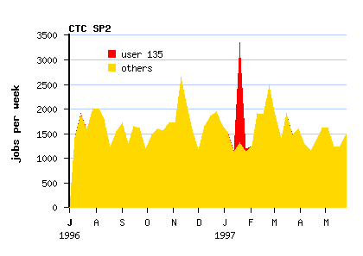
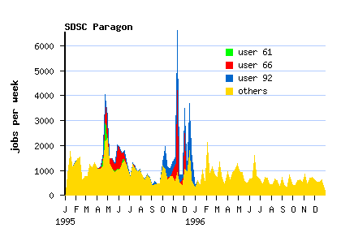
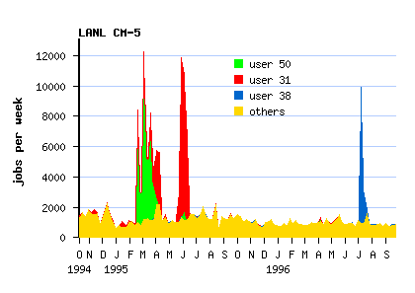
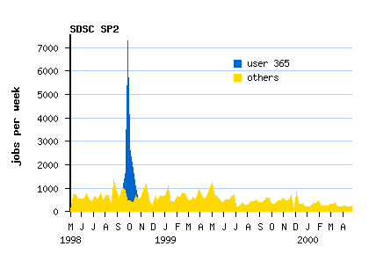

Slide 53
Effect on Performance Evaluation
Performance of full workload is some combination of desired and undesired classes
At best, undesired classes may dilute an effect (average is taken over more jobs)
At worst, undesired classes may cause instability
(paper in IPDPS 2006 next month)

Slide 54
To Clean or Not to Clean?
NO WAY!
Abnormalities and flurries do happen
Cleaning is manipulating real data
If you manipulate data you can get any result you want
This is bad science
DEFINITELY!
Abnormalities are unique and not representative
Evaluations with dirty data are subject to unknown effects
Do not reflect typical system performance
This is bad science
Feitelson & Tsafrir, ISPASS 2006

Slide 55
My Opinion
The virtue of using “real” data is based on ignorance
Must clean data of known abnormalities
Must justify the cleaning
Must report on what cleaning was done
Need research on workload characterization to know what is typical and what is abnormal
Need separate evaluations regarding the effects of abnormalities

Slide 56
The “Signature”
A log reflects the behavior of the scheduler on the traced system
And its interaction with the users
And the users’ response to its performance
So there is no such thing as a “true workload”
Using a log to evaluate another scheduler may lead to unreliable results!
Shmueli & Feitelson, MASCOTS 2006

Slide 57
Example
Step 1: generate traces
  FCFS – a simple scheduler that cannot support a high load
  EASY – a more efficient backfilling scheduler
supercomputer site
low load
users
FCFS
activity
supercomputer site
high load
users
EASY
activity

Slide 58
Example
  FCFS – a simple scheduler that cannot support a high load
  EASY – a more efficient backfilling scheduler
supercomputer site
low load
users
FCFS
activity
supercomputer site
high load
users
EASY
activity

Slide 59
Example
Step 2: switch traces and use in regular simulation
  FCFS – a simple scheduler that cannot support a high load
  EASY – a more efficient backfilling scheduler
simulation
Overload!
low load
FCFS
activity
simulation
Too easy!
high load
EASY
activity

Slide 60
Example
Comparison of wait-time results:
Scheduler | Site-level simulation | Simulation with wrong trace | difference
FCFS | 1:35 | 22:30 | +1345%
EASY | 0:38 | 0:23 | -38%
Using the wrong trace can have a huge effect!
Conclusion:
Can’t use log from one
system to evaluate another!

Slide 61
Oh damn…

Slide 62
Outline for Today
Background – parallel job scheduling
Workload models ups and downs
Using logs directly ups and downs
Resampling workloads
Adding feedback
Examples of evaluation results

Slide 63
User-Based Workloads
The workload on a multi-user system is composed of the workloads by multiple users
Turn this into a generative process
  Create individual job streams per user
  Combine them
Need to know what “makes users tick”

Slide 64
User-Based Workloads
The workload on a multi-user system is composed of the workloads by multiple users
Turn this into a generative process
  Create individual job streams per user
  Combine them
Solves many of the problems noted before

Slide 65
Solved!
Load can be changed by having more (or less) users
Daily cycle due to natural user activity
Locality due to different users with different job characteristics
Easy to include or exclude flurries
Heavy-tailed sessions lead to self similarity as exists in many workloads

Slide 66
User-Based Workloads
The workload on a multi-user system is composed of the workloads by multiple users
Turn this into a generative process
  Create individual job streams per user
  Combine them
Solves many of the problems noted before
But where do we get per-user workloads?
  Must be realistic (like logs)
  Must be flexible (like models)

Slide 67
Resampling
Partition log into users (represented by their job streams)
Sample from the user pool
Combine job streams of selected users
Zakay & Feitelson, ICPE 2013

Slide 68
Resampling

Slide 69
Resampling

Slide 70
Resampling
Long-term users pool

Slide 71
Resampling
Long-term users pool
Temporary users pool

Slide 72
Resampling
Long-term users pool
Temporary users pool

Slide 73
Resampling
Long-term users pool
Temporary users pool
Generating a new workload

Slide 74
Resampling
Long-term users pool
Temporary users pool
Generating a new workload

Slide 75
Details
User activity is synchronized with the daily and weekly cycles
  Always start at same day and time
Number of users defaults to that of the original log on average
In initialization users start from a random week of activity
Each simulated week a random number of new temporary users “arrive”
Long term users are regenerated as needed

Slide 76
Benefits
All the benefits of user-based workloads
  Realism
  Locality
  Daily and weekly cycles
  Ability to change the load
  Include or exclude specific behaviors
Plus ability to create multiple different workloads with the same statistics
Plus ability to extend workload by continued resampling beyond original length

Slide 77
Whoop-dee-doo!

Slide 78
But…
The original log contains a signature of the interaction between the users and the scheduler
And each user’s job stream includes a signature of interaction with other users
  When one creates overload, the others back off
So if we remix them randomly we create an unrealistic workload

Slide 79
Evidence
In weeks with many jobs, they are small
In weeks with large jobs, there are few of them
Users react to load conditions when submitting new jobs
Jobs are not independent

Slide 80
Oh damn…

Slide 81
Outline for Today
Background – parallel job scheduling
Workload models ups and downs
Using logs directly ups and downs
Resampling workloads
Adding feedback
Examples of evaluation results

Slide 82
Independence vs. Feedback
Replaying a log to recreate a workload assumes an open system model
  Large user population insensitive to system performance
  Jobs’ arrivals are independent of each other
But real systems are often closed
  Limited user population
  New jobs submitted after previous ones terminate
This leads to feedback from system performance to workload generation

Slide 83
Feedback Determines Load
Generated jobs
as function of
response time
Response time
Performance as
function of load
Generated load
Notes:
Like equilibrium in economics supply and demand curves

Slide 84
Old Model
workload
scheduler
wait queue
Notes:
In evaluations also need to simulate user behavior!

Slide 85
Site-Level Model
user 1
job
job submission
stream
model
from log
scheduler
S
W
user N
wait queue
job
job submission
stream
model
from log
S
W
feedback
jobs
submit/wait
Shmueli & Feitelson, MASCOTS 2006
Notes:
In evaluations also need to simulate user behavior!

Slide 86
Users are Human
We need a model of how they behave
Alternate “submit” and “wait” is too simplistic…
  Can become frustrated with the system
  Can become tired and go to sleep

Slide 87
User Behavior Model
Users work in sessions
If a job’s response time is short, there is a high probability for a short think time and an additional job
If a job’s response time is long, there is a high probability for a long think time
  Possibly the session will end
“Fluid” model: retain sessions from log and allow jobs to flow according to feedback
  Maintains daily/weekly cycle
Zakay & Feitelson, MASCOTS2014

Slide 88

THIS IS DIFFERENT
Old School
New Idea
Fair evaluations require equivalent conditions
Equivalent conditions = same job stream
Retain jobs and timestamps from log (at possible expense of dependencies)
Fair evaluations require equivalent conditions
Equivalent conditions = same users with same behaviors
Retain logical structure of workload (dependencies a Feedback) at possible expense of timestamps

Slide 89
Analogy
Paxson and Floyd / difficulties in simulating the Internet
Packet traffic is easy to record, but
  Depends on network conditions
  And how TCP congestion control reacts to it
So need to generate workload at the source level (the application that sent the packets)
And add feedback effects in the simulation

Slide 90
Implications
Performance metrics change
  Better scheduler a more jobs a higher throughput
  Better scheduler a more jobs a maybe higher response time (traditionally considered worse!)
Feedback counteracts efforts to change load
  Higher load a worse performance a users back off
  Negative feedback effect
  Leads to stability: system won’t saturate!
  Identify maximal achievable utilization!!

Slide 91
Outline for Today
Background – parallel job scheduling
Workload models ups and downs
Using logs directly ups and downs
Resampling workloads
Adding feedback
Examples of evaluation results

Slide 92
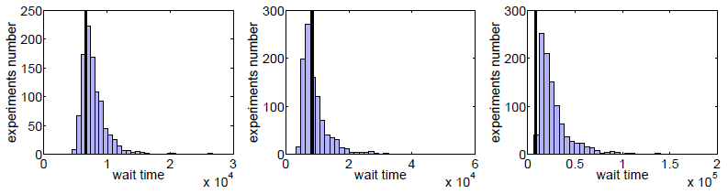
Validation
Perform 1000 simulations with resampling
Small spread around original log: valid
Original log is an outlier: mismatch with log signature?
Can use median as representative result
CTC SP2
SDSC DS
Blue
Zakay & Feitelson, ICPE 2013

Slide 93
Measure Throughput
In conventional log-driven simulations the throughput is dictated by the log
But in real life performance affects user behavior
Throughput is an important metric for productivity and user satisfaction

Slide 94
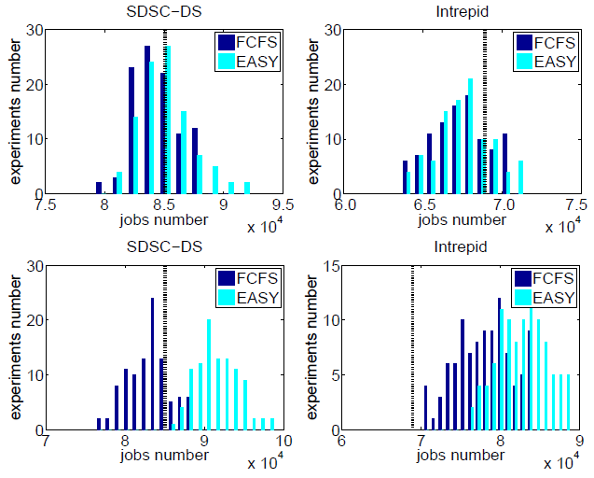
No feedback
With feedback
Zakay & Feitelson, CloudCom 2015

Slide 95
Adjust Log
Extend simulated duration
  Facilitate better convergence of results
  Help avoid initial “warmup” period
Increase / decrease load on the system
  Identify saturation point – an important metric
  Also identify and count frustrated users
  Make use of low-load logs from underused systems
  Realistic evaluation of overload with throttling effect
Oversample rare behaviors (flurries)
Zakay & Feitelson, ICPE 2013

Slide 96
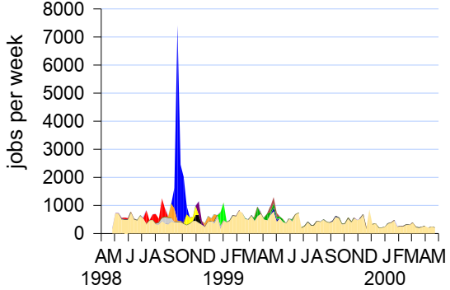
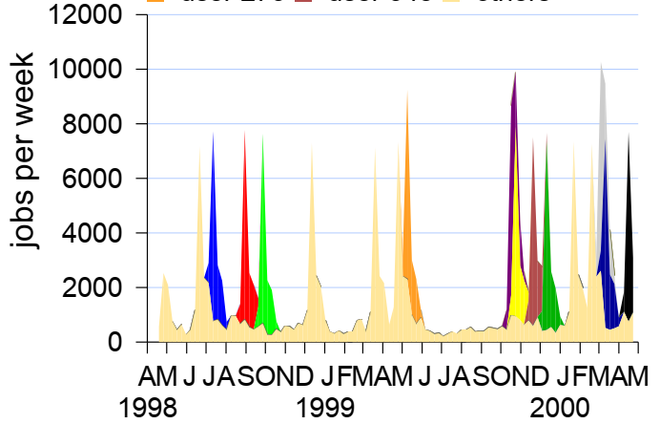
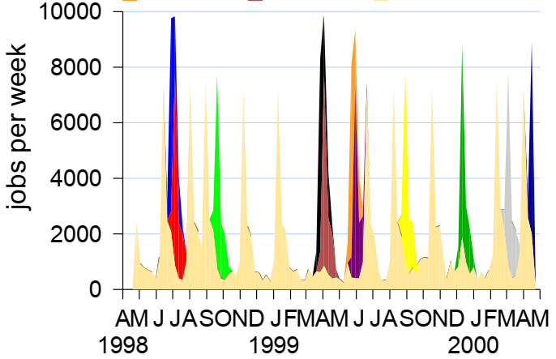
Adding Flurries
How do flurried affect the performance of other jobs?
Original log

Slide 97
User-Aware Scheduling
Prioritize jobs with short expected response times
  Prioritize users with recent activity (LIFO-like)
  An attempt to keep users satisfied and enhance user productivity
This also improves system utilization and throughput
Balance with job seniority to prevent starvation
Requires feedback for fair evaluation
Shmueli & Feitelson, IEEE TPDS 2009; Zakay & Feitelson, CloudCom 2015

Slide 98
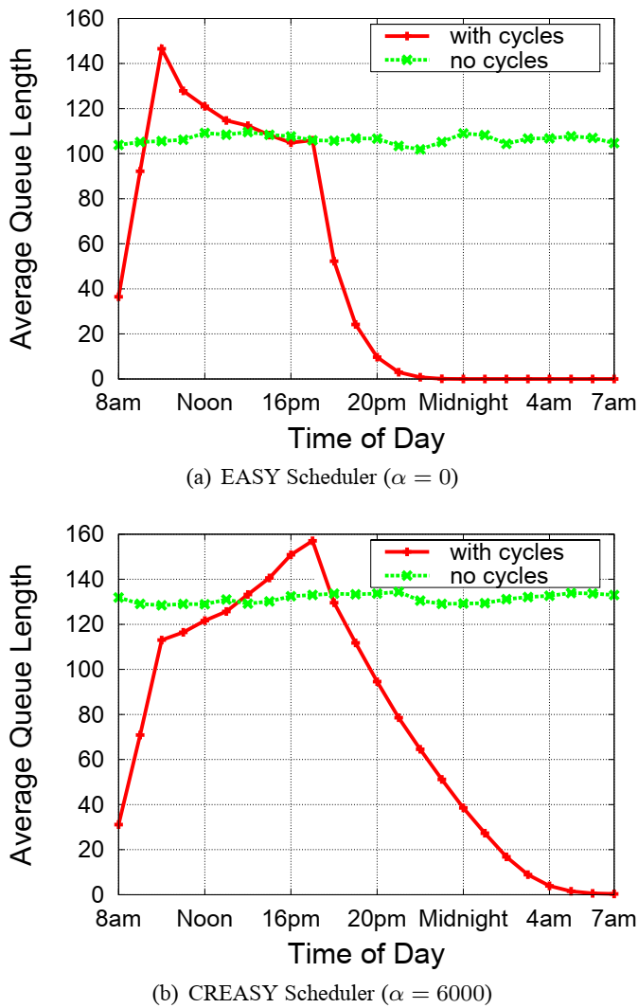
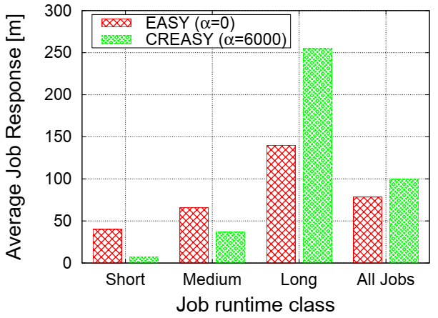
User-Aware Scheduling

Slide 99
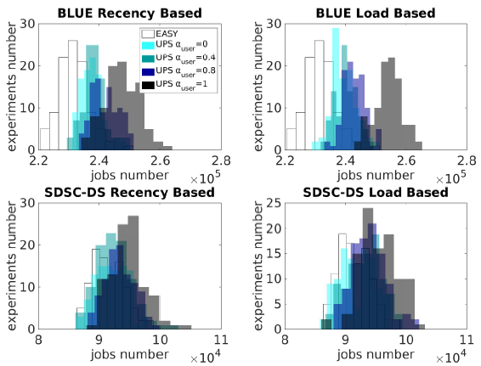
User-Aware Scheduling

Slide 100
Outline for Today
Background – parallel job scheduling
Workload models ups and downs
Using logs directly ups and downs
Resampling workloads
Adding feedback
Examples of evaluation results
Conclusions

Slide 101
Summary of Main Results
Resampling with feedback is a new way to use workload logs
  Retain realism of logs
  Support flexibility
  Measure throughput (=satisfaction?)
  Avoid original system’s signature
New interpretation of “fair evaluations”: same users instead of same jobs

Slide 102
Thank You!
My students
  Dan Tsafrir (PhD 2006)
  Edi Shmueli (PhD 2008)
  Netanel Zakay (PhD 2017)
Financial support
  Israel Science Foundation
  Ministry of Science and Technology
Parallel Workloads Archive
  CTC SP2 – Steven Hotovy and Dan Dwyer
  SDSC Paragon – Reagan Moore and Allen Downey
  SDSC SP2 and DataStar – Victor Hazelwood
  SDSC Blue Horizon – Travis Earheart and Nancy Wilkins-Diehr
  LANL CM5 – Curt Canada
  LANL O2K – Fabrizio Petrini
  HPC2N cluster – Ake Sandgren and Michael Jack
  LLNL uBGL – Moe Jette

Slide 103
Whoop-dee-doo!

