Slide 1
On the Vulnerability of the Proportional Fairness Scheduler to Retransmissions Attacks
Udi Ben-Porat ETH Zurich Switzerland
Anat Bremler-Barr IDC Herzliya Israel
Hanoch Levy Tel-Aviv University Israel
Bernhard Plattner ETH Zurich Switzerland
INFOCOM 2011

Slide 2
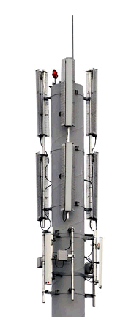
Wireless Scheduling
Players: Base Station (BS) and Clients
Time is divided to time slots
In each slot, data is sent to one user only
Clients have variable channel conditions
The scheduler selects a client for transmission based on the reported channel condition of the users
Scheduler’s objectives:
Good overall throughput performance of the system
Fairness among users (avoid starvation)

Slide 3
PROBLEM & Contributions
The Common Scheduler – Proportional Fairness (PFS)
Fair & Efficient (widely studied and deployed)
PROBLEM: Retransmission policy overlooked
ISSUE: Malicious Users can Downgrade Performance
Contributions:
Expose vulnerability of the PFS wireless scheduler
Examine and Analyze potential solutions
Propose a solution that maintains fairness and immune to attacks
* All claims in this work are analytically proved and backed up by simulations.

Slide 4
Proportional Fairness Scheduler (PFS) – User Info
Rate (at time t)
R_{i}(t)
V_{i}(t)
A_{i}(t)
Priority Value
Throughput Average (until t)
The user with the highest priority is scheduled

Slide 5
Proportional Fairness Scheduler (PFS)
A₁(t) =200
A₂(t) =100
Throughput Average
V₁(t) = 2
V₂(t) = 3
Priority Value
Priority Value
R₁(t) = 400 b/s
R₂(t) = 300 b/s
Rate
Rate
DATA
User 1
Base Station
User 2

Slide 6
Throughput Average A_{i}(t)
Throughput Average update – “Admitted Average”:
1_{i}^{rcv}(t) = 1 if user i received a transmission in time t (o/w 0)
R_{i}(t) is the “price” the user “pays” per transmission
Higher “price” → Higher A_{i}(t) → Harder to “win” future time slots
A_{i}(t+1) = (1- ε)A_{i}(t) + ε1_{i}^{rcv}(t)R_{i}(t)

Slide 7
Frame Losses and Retransmissions
Hmm…
Sorry, I didn’t get it.
Send again please!
Hey!
What about us?
OK, just a moment
DATA
1. When to retransmit a lost frame?
Should pending retransmissions get the highest priority?
2. What is the real received data rate?
Due to losses, R_{i}(t) does not reflect the real rate to the user

Slide 8
Frame Losses and Retransmissions
When to retransmit a lost frame?
„Fast Ret.“
Retransmit immediately (ignore other users)
„Slow Ret.“
Some other user has higher priority? - Delay retransmission
Effective Rate - R^{e}_{i}(t)
Effective Rate = The rate the user is expected to receive
Example: R_{i}(t) = 200 Kb/s , Loss Prob. = 0.2 → R^{e}_{i}(t) = 160 Kb/s
V_{i}(t) = R^{e}_{i}(t) / A_{i}(t)

Slide 9
Frame Losses and Retransmissions
Regular User
Time | Data | ack/nak | Payment
1
2
t = 1
101000100101010110111000
200
Kb/slot
= 0
200Kb
0 Kb
Rate selected: 200 b/s
Prob. For frame loss = 0.2
R^{e}_{i}(t) = 200(1-0.2)=160 b/s
NEW DATA
Base Station
User i

Slide 10
Frame Losses and Retransmissions
Regular User
Time | Data | ack/nak | Payment
1
2
t = 2
101000100101010110111000
200
Kb/slot
= 200
200Kb
0 Kb
200Kb
200 Kb
Rate selected: 200 b/s
Prob. For frame loss = 0.2
R^{e}_{i}(t) = 200(1-0.2)=160 b/s
RETRANSMISSION
Base Station
User i

Slide 11
Our Contributions
Retransmissions Scheduling – Vulnerable!
Propose Immune & Fair solutions
 | Fast Ret. |  | Slow Ret.
Averaging Method | Immune | Fair | Immune | Fair
Admitted Avg. (original) | ✗ | ✓ | ✗ | ✓
Transmission Avg. | ✓ | ✗ | ✓ | ✗
Effective Avg. | ✗ | ✓ | ✓ | ✓
Initial Effective Avg. | ✓ | ✓

Slide 12
Admitted Average – Malicious Attack
Rate selected: 200 b/s
Prob. For frame loss = 0.2
R^{e}_{i}(t) = 200(1-0.2)=160 b/s
Malicious user
Time | Data | Ack/Nak | Payment
1
2
3
4
5
101000100101010110111000
200
Kb/slot
= 0
200Kb
0 Kb
NEW DATA
Base Station
Malicious
User

Slide 13
Admitted Average – Malicious Attack
Rate selected: 200 b/s
Prob. For frame loss = 0.2
R^{e}_{i}(t) = 200(1-0.2)=160 b/s
Malicious user
Time | Data | Ack/Nak | Payment
1
2
3
4
5
101000100101010110111000
200
Kb/slot
= 200
200Kb
0 Kb
200Kb
0 Kb
200Kb
0 Kb
RETRANSMISSION
200Kb
0 Kb
200Kb
200 Kb
Base Station
Malicious
User

Slide 14
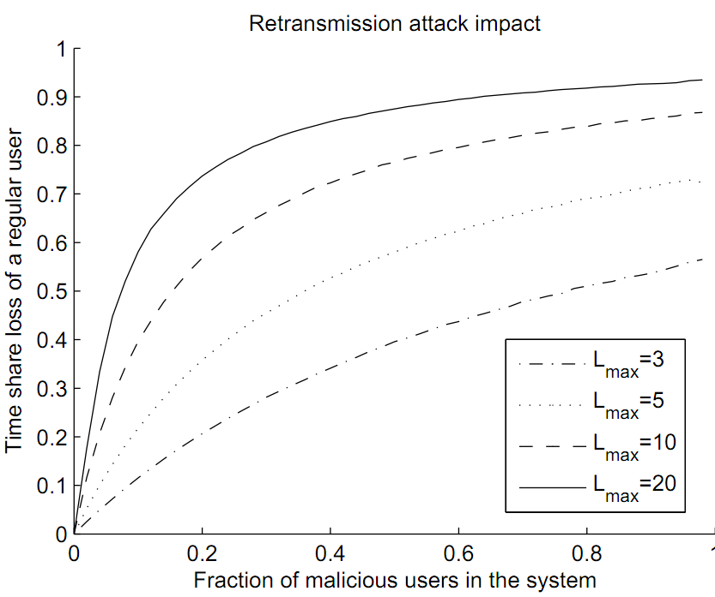
Retransmissions Attack – Simulation Results
Example:
10% are malicious
# of retransmissions are limited to L_{max} =10
40% time share loss for every regular user
X – Percentage of malicious users
Y – Time share loss for regular users

Slide 15
Results
 | Fast Ret. |  | Slow Ret.
Averaging Method | Immune | Fair | Immune | Fair
Admitted Avg. (original) | ✗ | ✓ | ✗ | ✓

Slide 16
Sol #1 – Transmission Average
Sol #1 - “Pay” for every transmitted frame
1_{i}^{snd}(t) = 1 if a frame was sent (o/w 0)
A_{i}(t+1) = (1- ε)A_{i}(t) + ε1_{i}^{snd}(t)R_{i}(t)

Slide 17
Immunity of “Transmission Average”
Regular User
Time | Data | Ack/Nak | Payment
1
2
Malicious user
Time | Data | Ack/Nak | Payment
1
2
3
4
5
101000100101010110111000
101000100101010110111000
200Kb
200 Kb
200Kb
200 Kb
200Kb
200 Kb
200Kb
200 Kb
Total “Payment”: 400Kb
200Kb
200 Kb
The Scheduler is immune to attack
What about Fairness?
200Kb
200 Kb
200Kb
200 Kb
Total “Payment”: 1000Kb

Slide 18
Transmission Average – Distorted Fairness
2 Regular users |  |  |  |  | Results*
User | Effective Rate R^{e}_{i}(t) | Rate R_{i}(t) | Frame Loss Prob. | “Payment” per bit | Time Share | Download Speed
A | 100 b/s | 200 b/s | 0.5 | 1/(1-0.5) = 2 | 38% | 38 b/s
B | 90 b/s | 100 b/s | 0.1 | 1/(1-0.1) = 1.1 | 62% | 55.8 b/s
User A has a better channel condition than User B, but still…
…gets smaller time share
…receives less throughput
This stands against any notion of fairness!
* Long run results. Derived from an analytical result proved in the paper.

Slide 19
Results
 | Fast Ret. |  | Slow Ret.
Averaging Method | Immune | Fair | Immune | Fair
Admitted Avg. (original) | ✗ | ✓ | ✗ | ✓
Transmission Avg. | ✓ | ✗ | ✓ | ✗

Slide 20
Sol #2 – Effective Average
“Pay for what I expect you to receive”
Immune: Malicious has to pay for excessive ret.
Fair: A_{i}(t+1) = The throughput user i actually received
A_{i}(t+1) = (1- ε)A_{i}(t) + ε1_{i}^{snd}(t)R^{e}_{i}(t)

Slide 21
Effective Average (Sol. #2)
Regular user
Time | R^{e}_{i}(t) Effective Rate | Data | ACK/NAK | Payment
1
3
101000100101010110111000
150 b/s
300 b
150 b/s
150 b/s
300 b
150 b/s
Regular user: 300 b/s, 2 transmissions
Rate selected: 300 b/s
Frame loss Probability = 1/2
R^{e}_{i}(t) = 150 b/s

Slide 22
Effective Average (Sol. #2) for Fast retransmissions
Malicious user
Time | R^{e}_{i}(t) Effective Rate | Data | ACK/NAK | Payment
1
2
3
101000100101010110111000
150 b/s
300 b
150 b/s
10 b/s
10 b/s
10 b/s
10 b/s
Rate selected: 300 b/s
Frame loss Probability = 1/2
R^{e}_{i}(t) = 150 b/s
Regular user: 300 b/s, 2 transmissions
Malicious user: 170 b/s, 3 transmissions

Slide 23
Results
 | Fast Ret. |  | Slow Ret.
Averaging Method | Immune | Fair | Immune | Fair
Admitted Avg. (original) | ✗ | ✓ | ✗ | ✓
Transmission Avg. | ✓ | ✗ | ✓ | ✗
Effective Avg. | ✗ | ✓ | ✓ | ✓

Slide 24
Sol #3 – Initial Effective Rate (for Fast Ret.)
Initial Effective Rate (sol #3)
Every retransmission costs as the first transmission
F_{i} (t)= The last time slot where user i received an initial trans.
Choosing fast retransmission is preferred when:
Small changes in channel conditions between slots
Time slots are very short
Channel condition is stable
The preferred user in time t, is probably also the one in t+1
A_{i}(t+1) = (1- ε)A_{i}(t) + ε1_{i}^{snd}(t) R^{e}_{i}(F_{i} (t))

Slide 25
Results
 | Fast Ret. |  | Slow Ret.
Averaging Method | Immune | Fair | Immune | Fair
Admitted Avg. (original) | ✗ | ✓ | ✗ | ✓
Transmission Avg. | ✓ | ✗ | ✓ | ✗
Effective Avg. | ✗ | ✓ | ✓ | ✓
Initial Effective Avg. | ✓ | ✓

Slide 26
Conclusions
The Proportional Fairness Scheduler is vulnerable to retransmissions attacks
Both for Fast and Slow retransmission methods
We proposed modifications to PFS
Proved to be proportional fair and immune to ret. attacks
Both for Fast and Slow retransmission methods

Slide 27
Questions?

