Slide 1
Measuring and Analyzing Networks
Scott Kirkpatrick
Hebrew University of Jerusalem
April 12, 2011

Slide 2
Sources of data
Communications networks
  Web links – urls contained within surface pages
  Internet Physical network
  Telephone CDR’s
Social networks
  Links through common activity
    Movie actors, scientists publishing together
    Opt-in networking in Facebook et al.

Slide 3
Properties to be considered
“3 degrees of separation” and small world effects.
Robustness/fragility of communications
  Percolation under various modeled attacks
Spread of information, disease, etc…

Slide 4
Aggregates and Attributes
Degree distribution, betweenness distribution
Two-point distributions
  Degree-degree
    “assortative” or “disassortative”
Cluster coefficient and triangle counting
  Is the friend of my friend also my friend?
Variations on betweenness (not in the literature, but an attractive option)
Mark Newman’s SIAM Review paper – a great reference but dated.

Slide 5
K-Cores, Shells, Crusts and all that…
K-core almost as fundamental a graph property as the “giant component”:
  Bollobas (1984) defined K-core: maximal subgraph in which all nodes have K or more edges. Corollaries – it’s unique, it is w.h.probability K-connected, when it exists it has size O(N)
  Pittel, Spencer, Wormald (1996) showed how to calculate its size and threshold

Slide 6
K-Cores, Shells, Crusts and all that…
K-shell: All sites in the K-core but not in the (K+1)-core.
Nucleus: the non-vanishing core with largest K
K-crust: Union of shells 1,…(K-1), or all sites outside of the K-core.
A natural application is analysis of networks
  Replaces some ambiguous definitions with uniquely specified objects.

Slide 7
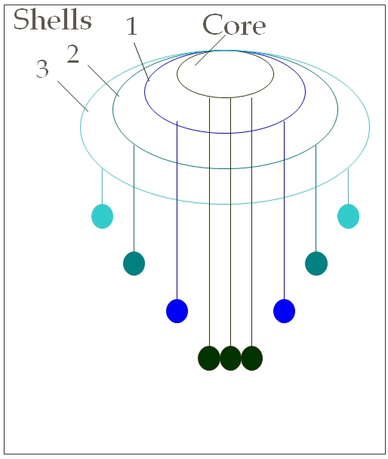
Faloutsos’ Jellyfish (Internet model)
Define the core in some way (“Tier 0”)
Layers breadth first around the core are the “mantle” and the edge sites are the tendrils

Slide 8
K-cores of Barabasi-like random network
L,M model gives non-trivial K-shell structure.
  (Shalit, Solomon, SK, 2000)
At each step in the construction, a new node makes L links to existing nodes, with probability proportional to their # ngbrs.
Then we add M links between existing nodes, also with preferential attachment.
Results for L=1, M = 1,2,4,8 (next slide) give lovely power laws. (Rome conference on complex systems, 2000)
Nucleus is just the endpoint.

Slide 9
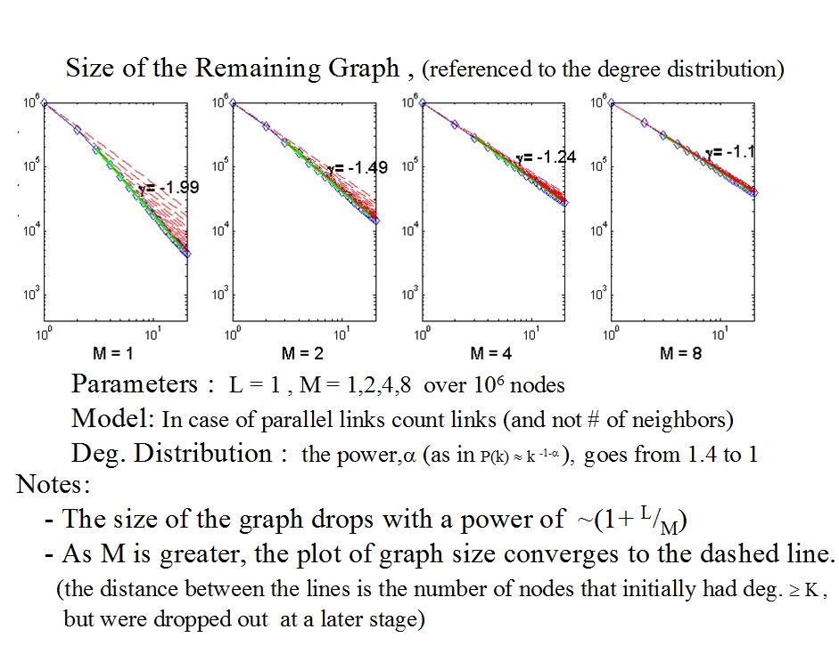
Results: L,M models’ K-cores

Slide 10
Next apply to the real Internet
DIMES data used at AS level
  (Shir, Shavitt, SK, Carmi, Havlin, Li)
  2004 to present day with relatively consistent experimental methodology
  K-shell plots show power laws with two surprises
The nucleus is striking and different from the mantle of this “Medusa”
Percolation analysis determines the tendrils as a subset connected only to the nucleus

Slide 11
Does degree of site relate to k-shell?

Slide 12
Distances and Diameters in cores

Slide 13
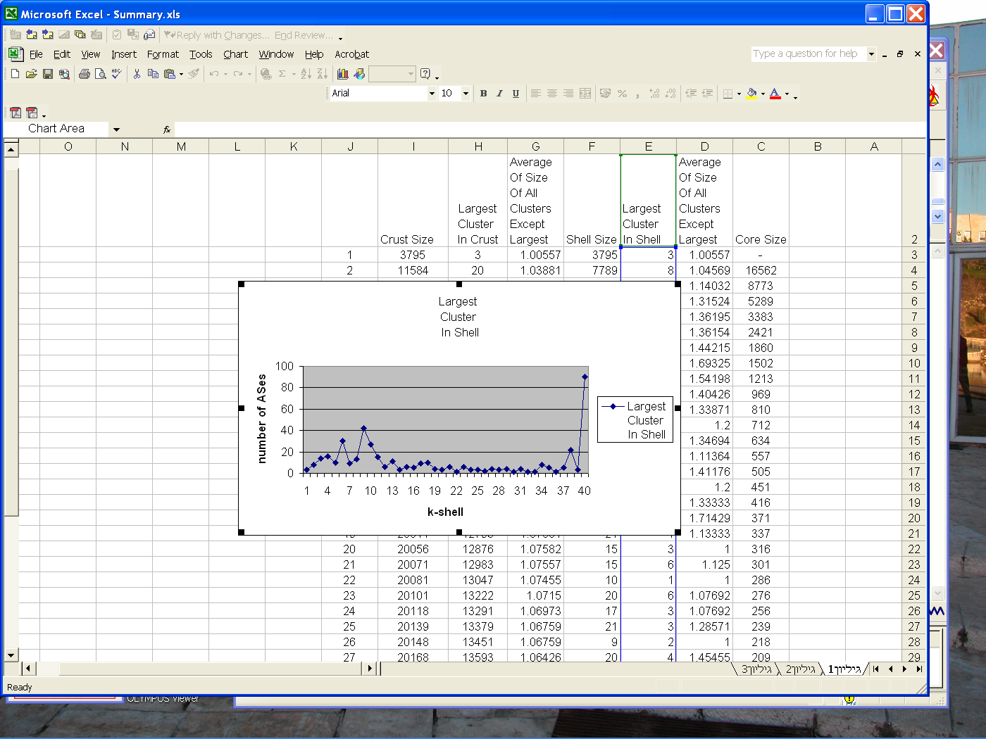
K-crusts show percolation threshold
← These are the hanging
tentacles of our (Red Sea)‏
Jellyfish
For subsequent analysis, we distinguish three components:
Core, Connected, Isolated
Largest cluster in each shell
Data from 01.04.2005

Slide 14
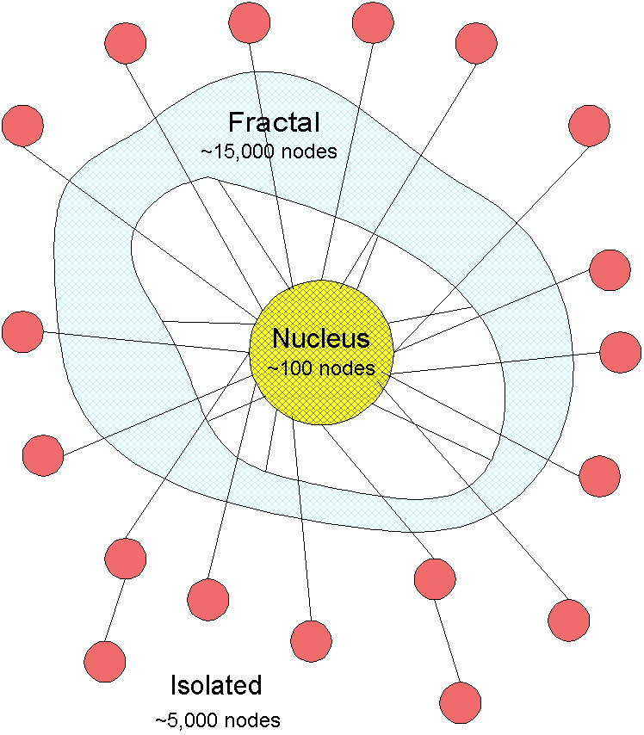
Meduza (מדוזה) model
This picture has been stable from January 2005 (kmax = 30) to present day, with little change in the nucleus composition. The precise definition of the tendrils: those sites and clusters isolated from the largest cluster in all the crusts – they connect only through the core.

Slide 15
Willinger’s Objection to all this
Established network practitioners do not always welcome physicists’ model-making
They require first that real characteristics be incorporated
  Finite connectivity at each router box
  Length restrictions for connections
  Include likely business relationships
  Only then let the modeling begin…
But ASs are objects with a fractal distribution
  From ISPs that support a neighborhood to global telcos and Google

Slide 16
How does the city data differ from the AS-graph information?
DIMES used commercial (error-filled) databases
  Results available on website
Cities are local, ASes may be highly extended (ATT, Level 3, Global Xing, Google)
About 4000 cities identified, cf. 25,000 ASes
Number of city-city edges about 2x AS edges
But similar features are seen
  Wide spread of small-k shells
  Distinct nucleus with high path redundancy
  Many central sites participate with nucleus
  A less strong Medusa structure

Slide 17
K-shell size distribution

Slide 18
City KCrusts show percolation, with smaller jump at nucleus

Slide 19
City locations permit mapping the physical internet

Slide 20
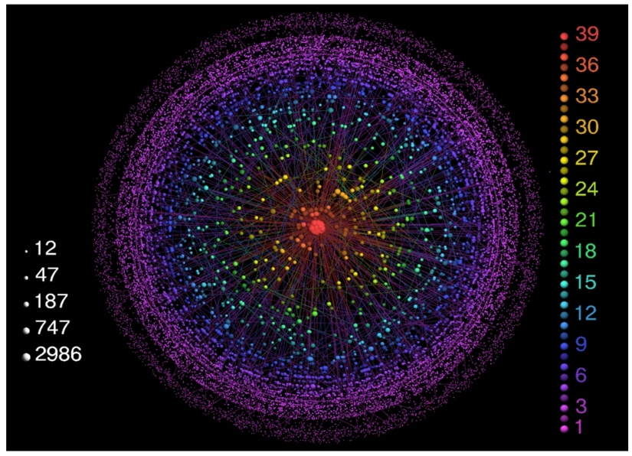
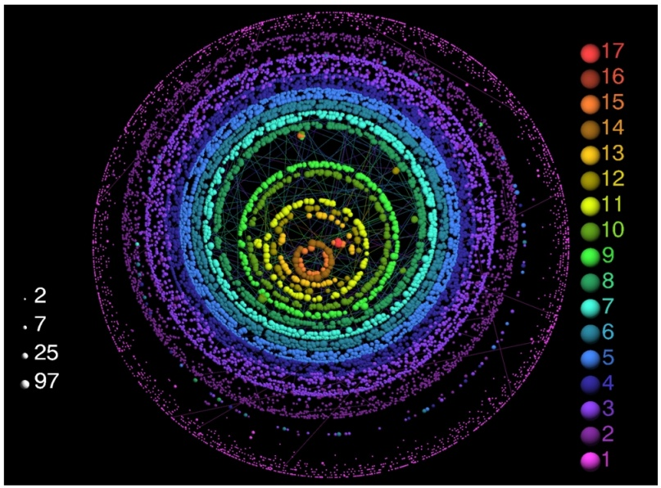
Are Social Networks
Like Communications Networks?
Visual evidence that communications nets are more globally organized:
  Indiana Univ (Vespigniani group) visualization tool
AS graph, ca 2006
Movie actors’ collaborations

Slide 21
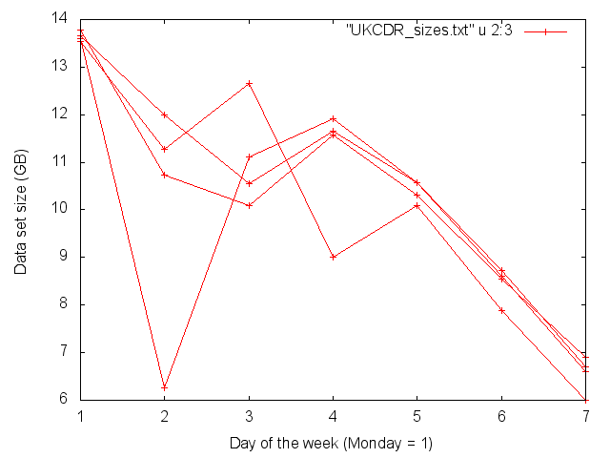
Diurnal variation suggests separating work from leisure periods

Slide 22
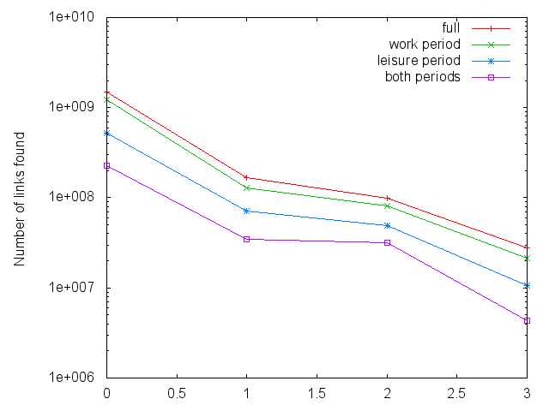
Telephone call graphs (“CDRs”)
Offer an Intermediate Case
7 B calls, over 28 days, Aug 2005
Cebrian,
Pentland,
SK
Full graph
Reciprocated
Reciprocated,
> 4 calls
Metro area PnLa only

Slide 23
Data sets available
Raw CDR’s NOT AVAILABLE—SECRET!!
Hadoop used to collect full data sets, total #calls. aggregated for each link, with forward and reverse, work and leisure separated.
Analysis done for all links
Then for reciprocated links
Finally for major cities or metro areas.

Slide 24
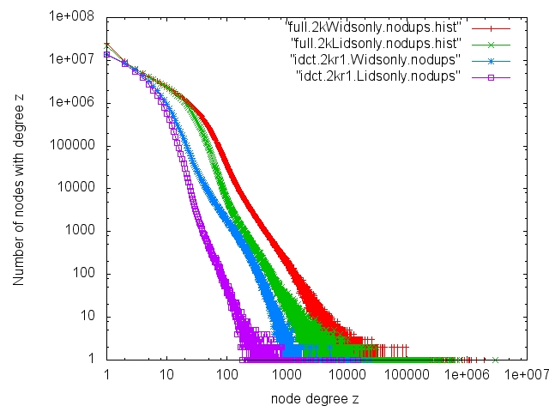
How do work and leisure differ?

Slide 25
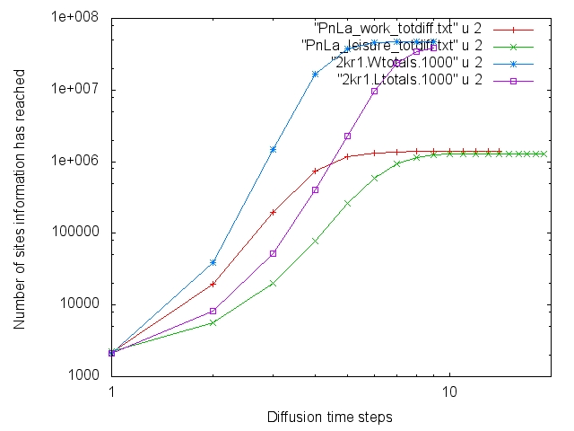
Diffusion of information from the edges
Faster in work than in leisure networks

Slide 26
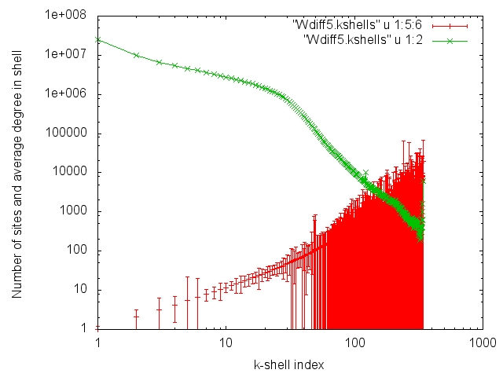
K-shell structure, full set, work period

Slide 27
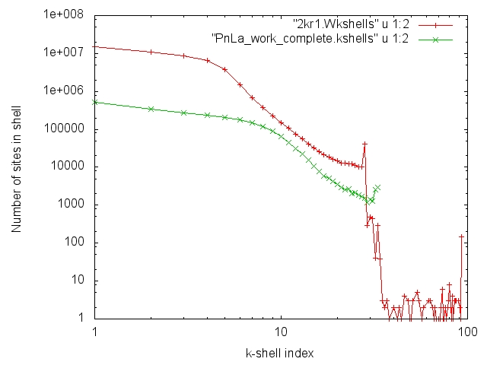
Work characteristics persist on smaller scales

Slide 28
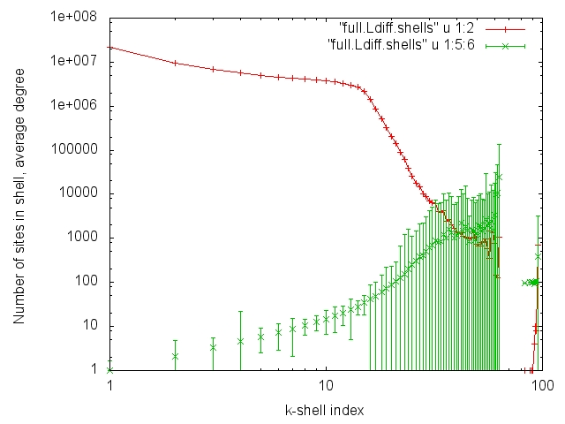
K-shell structure, full data set, Leisure

Slide 29
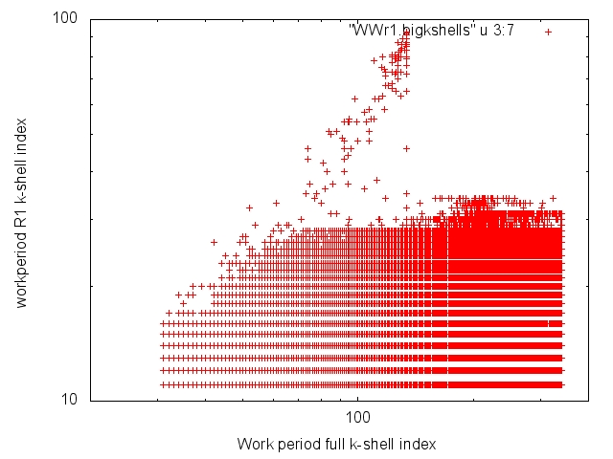
Mysteries (Work period, full, R1)

Slide 30
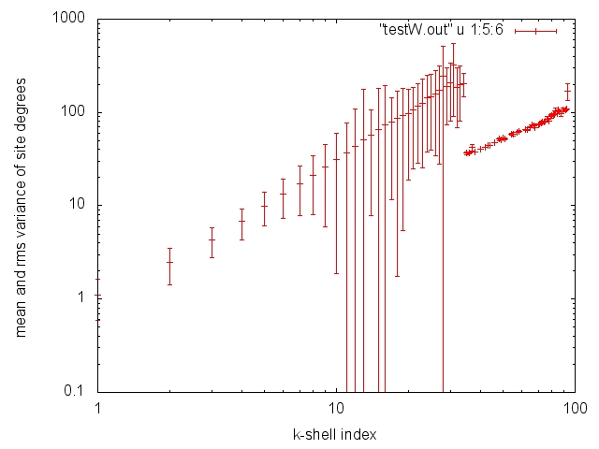
Mysteries, ctd.

